Slide 1
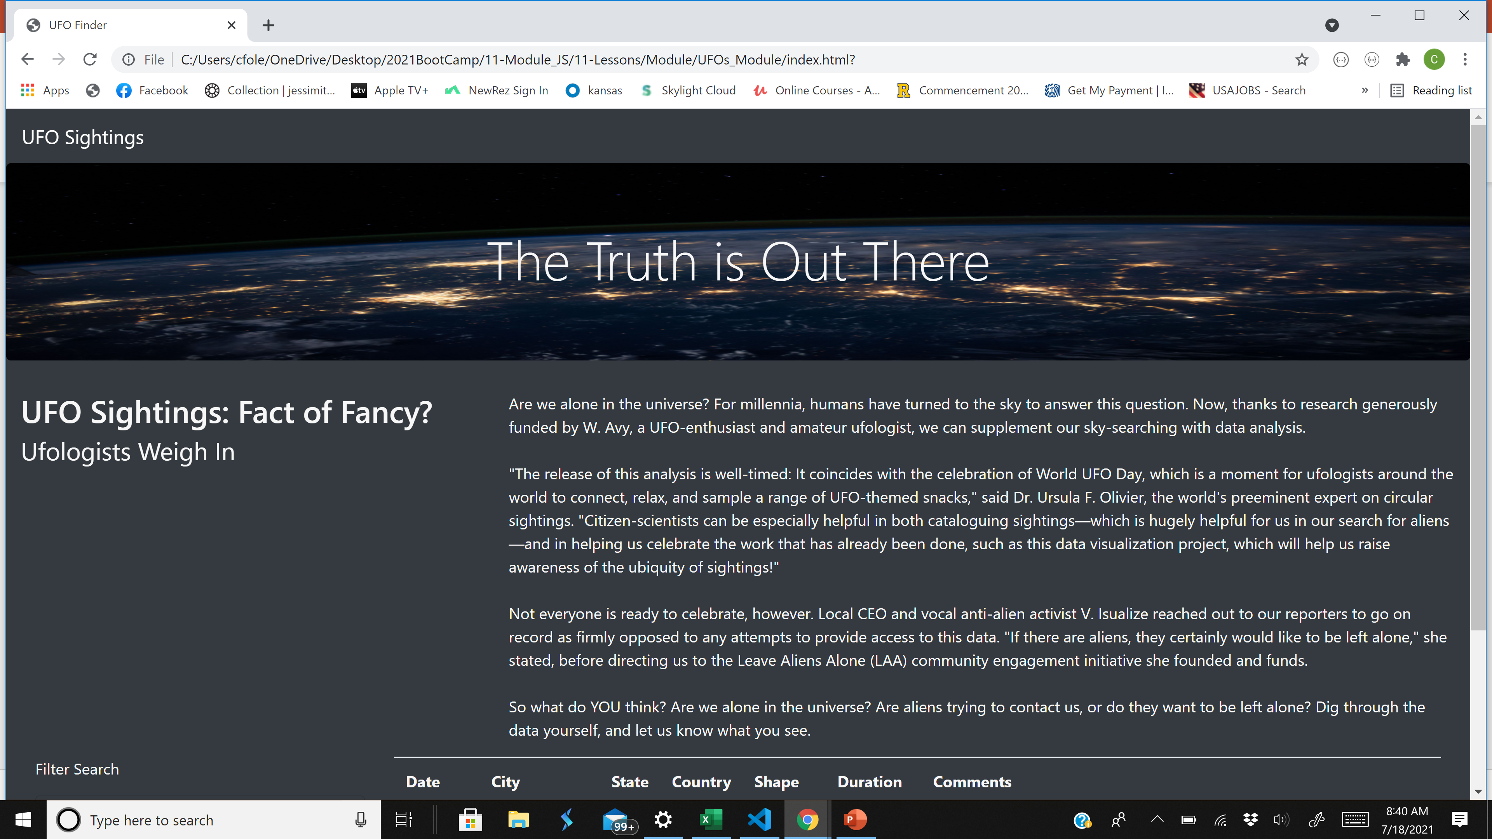
Top Part of the UFO Website

Slide 2
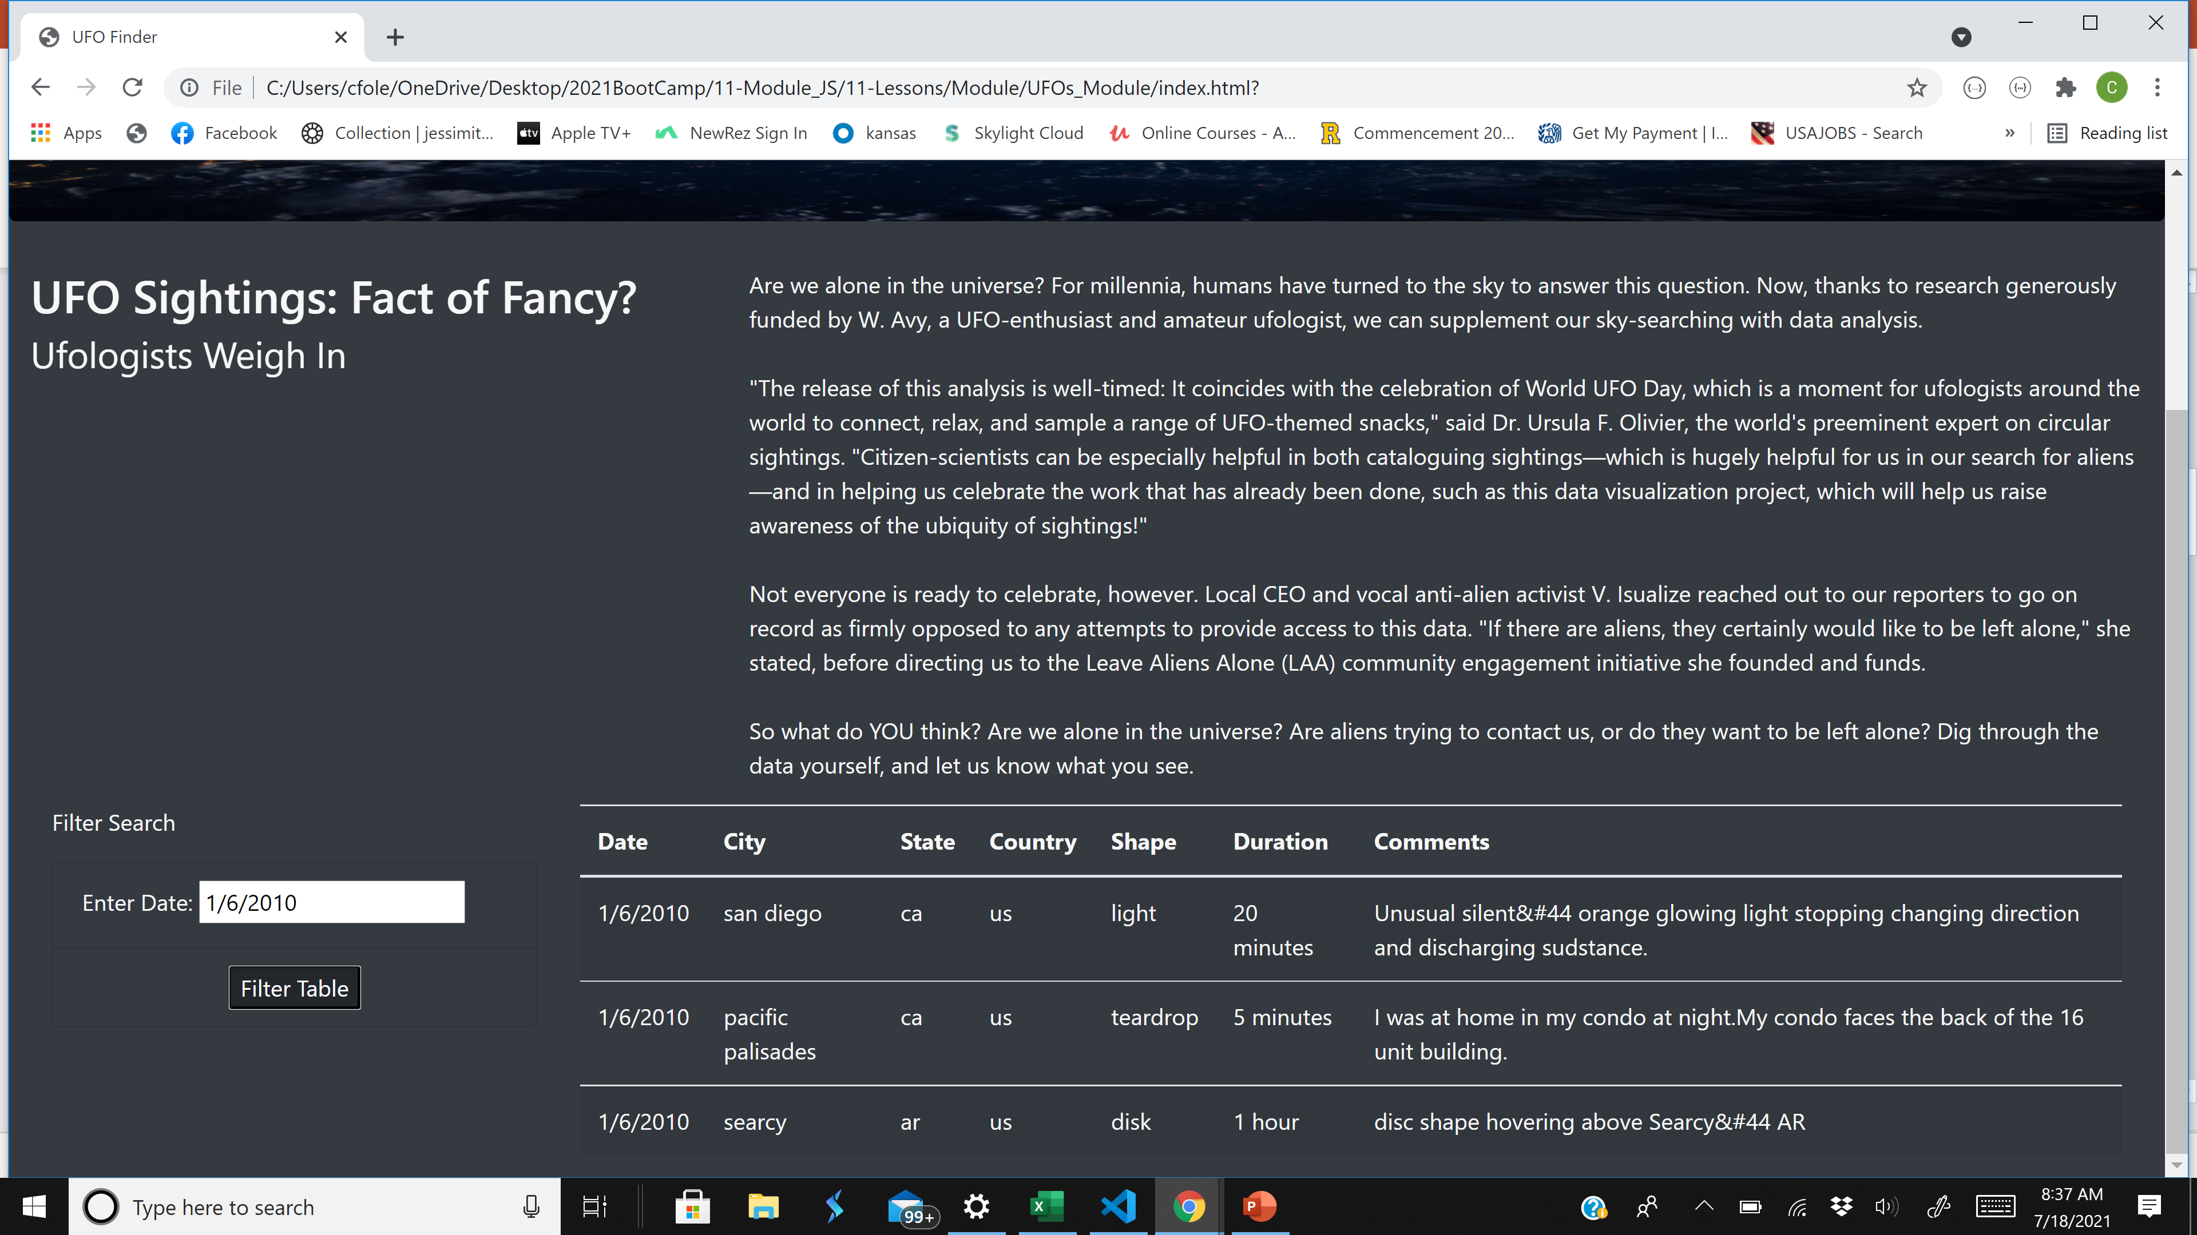
Initial Dynamic Table with a Date Search Option

Slide 3
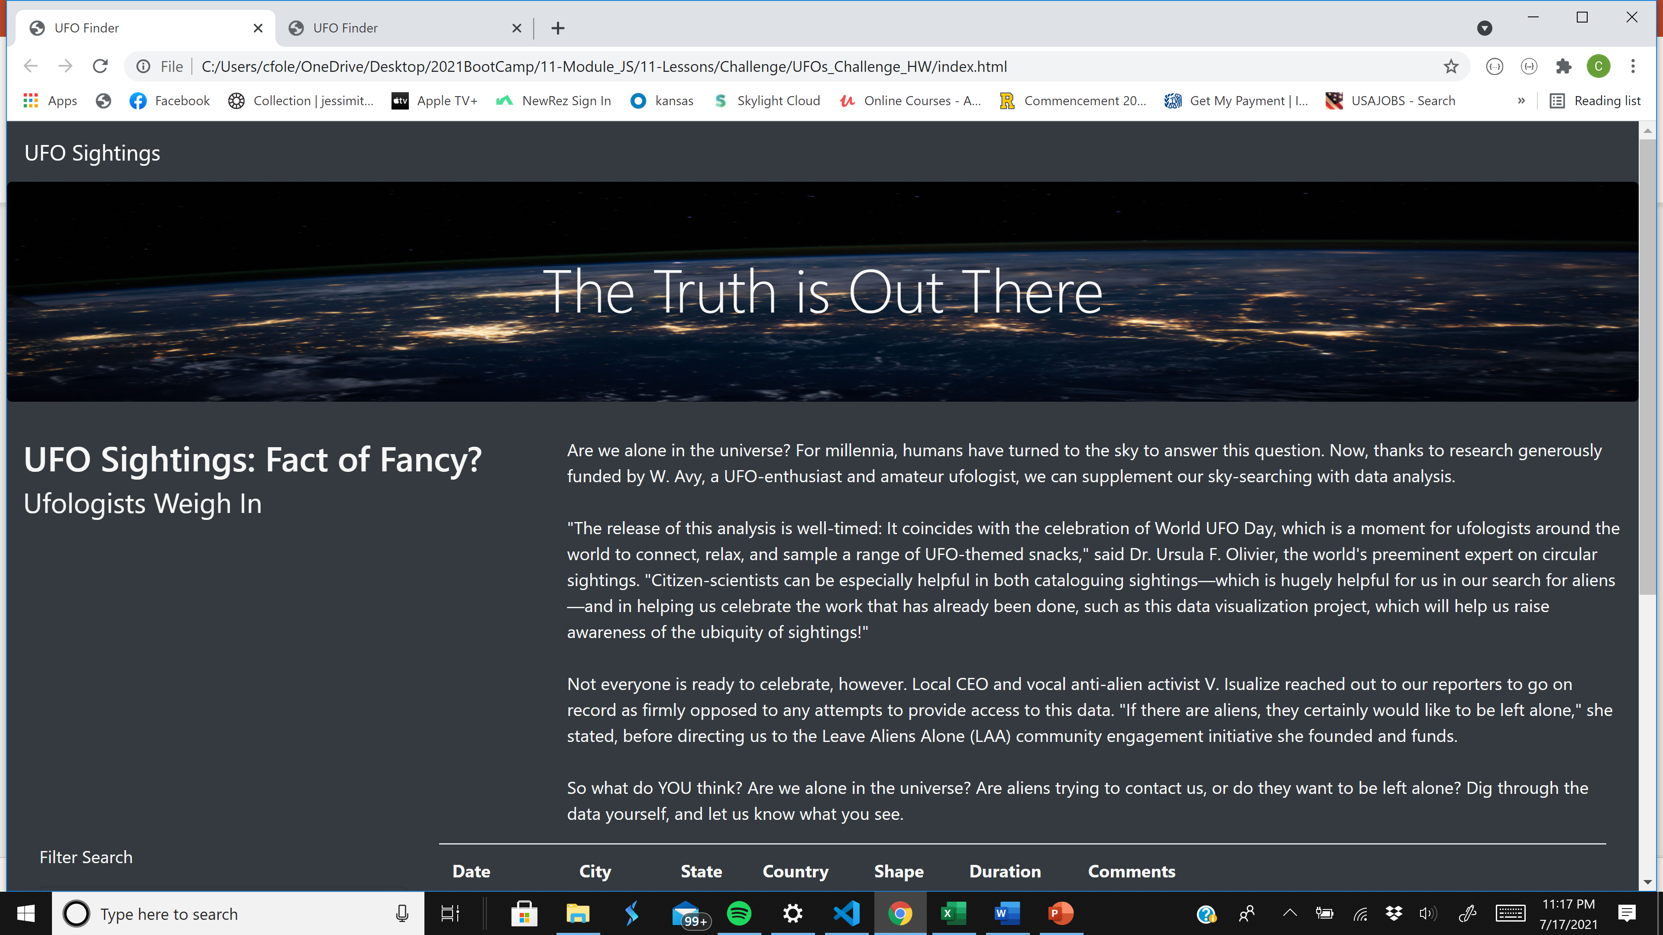

Slide 4
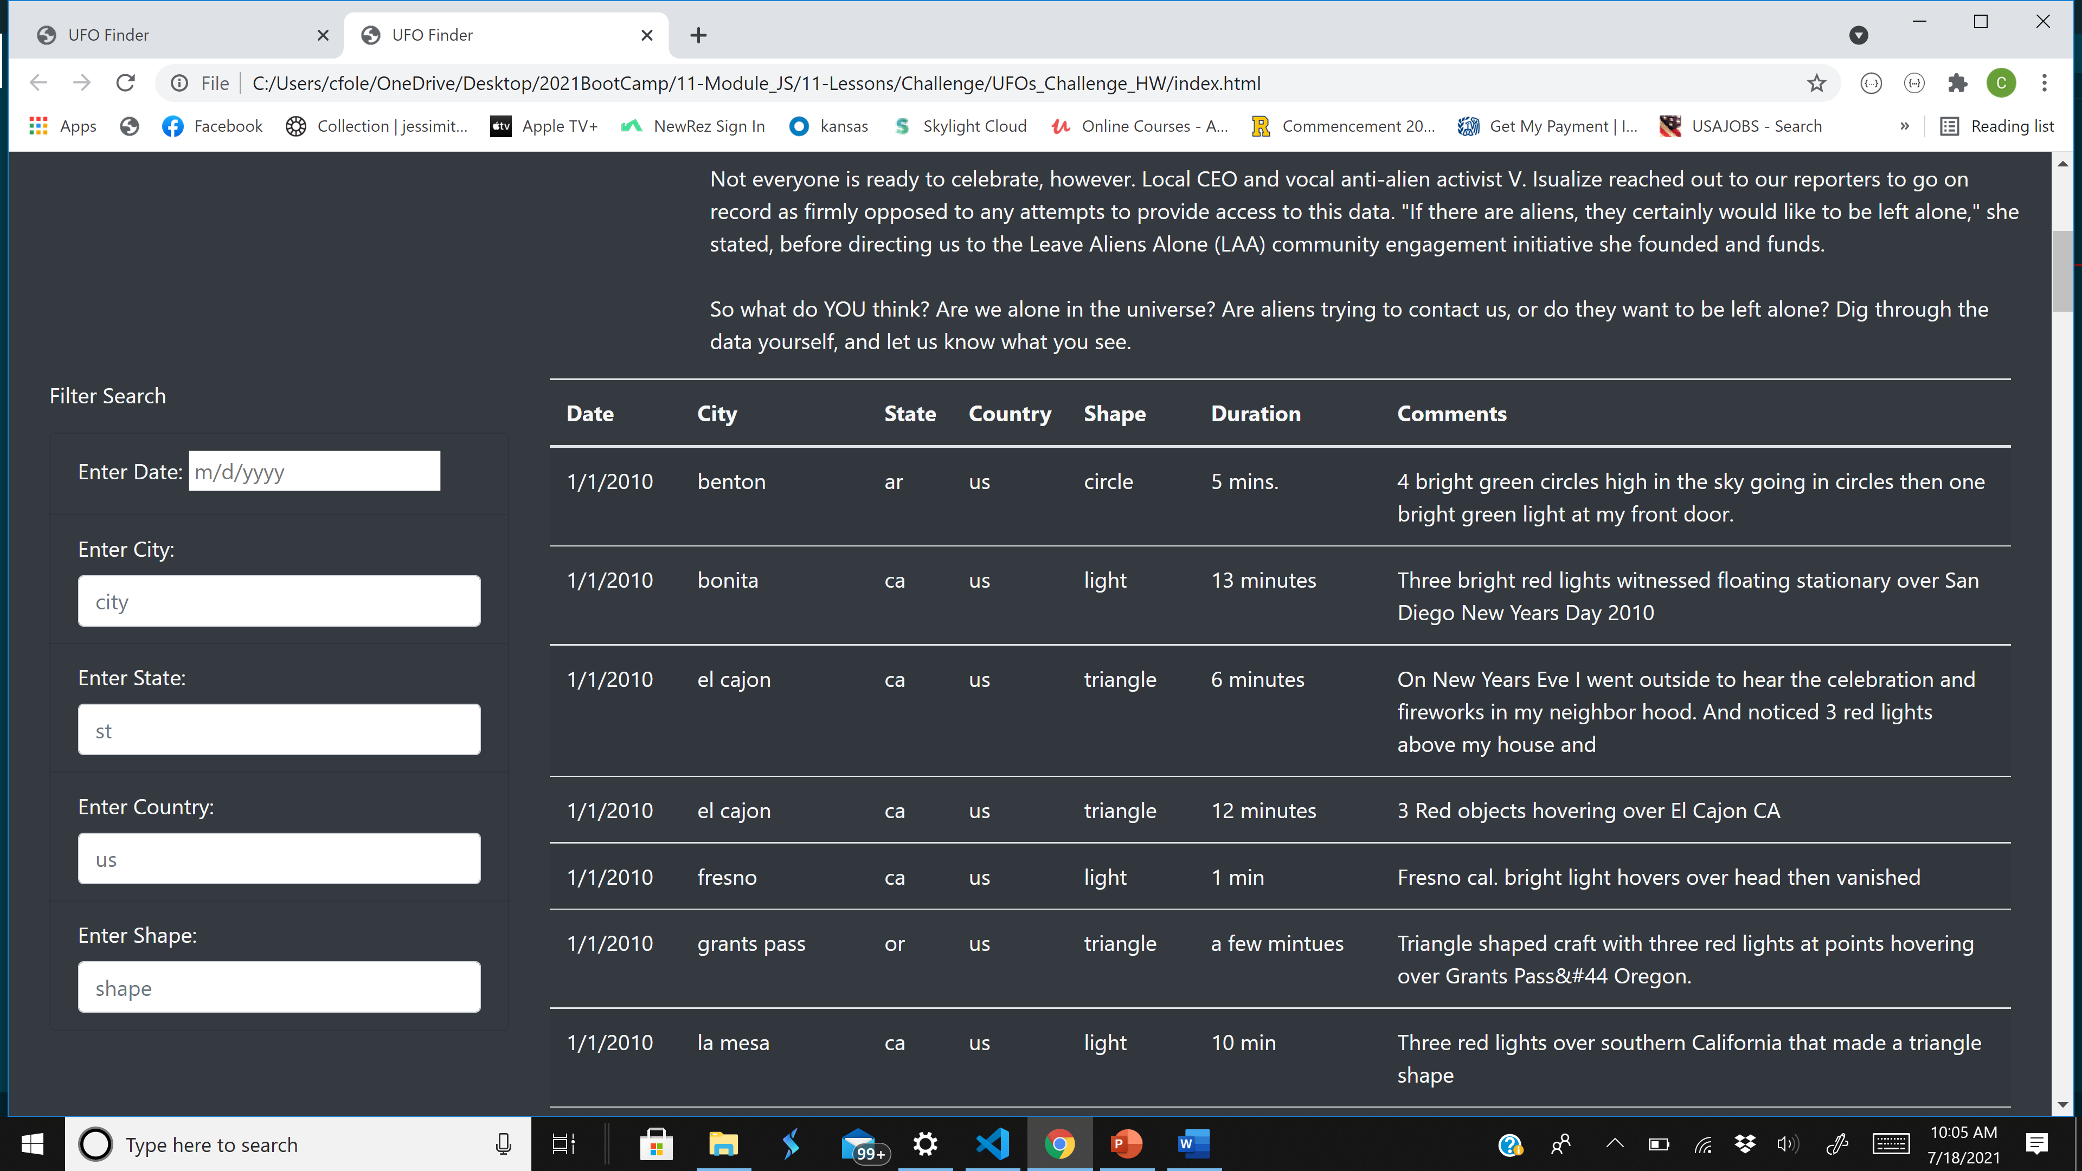
Enhanced Dynamic Table with a Multi-Layer Search Criteria.

Slide 5
The criteria format must match the data format in the table to get a return. Please note that the data in the table is in lowercase AND the search filter is case sensitive.
Enhanced Dynamic Table with a Multi-Layer Search Criteria. Please note the input tips.

Slide 6
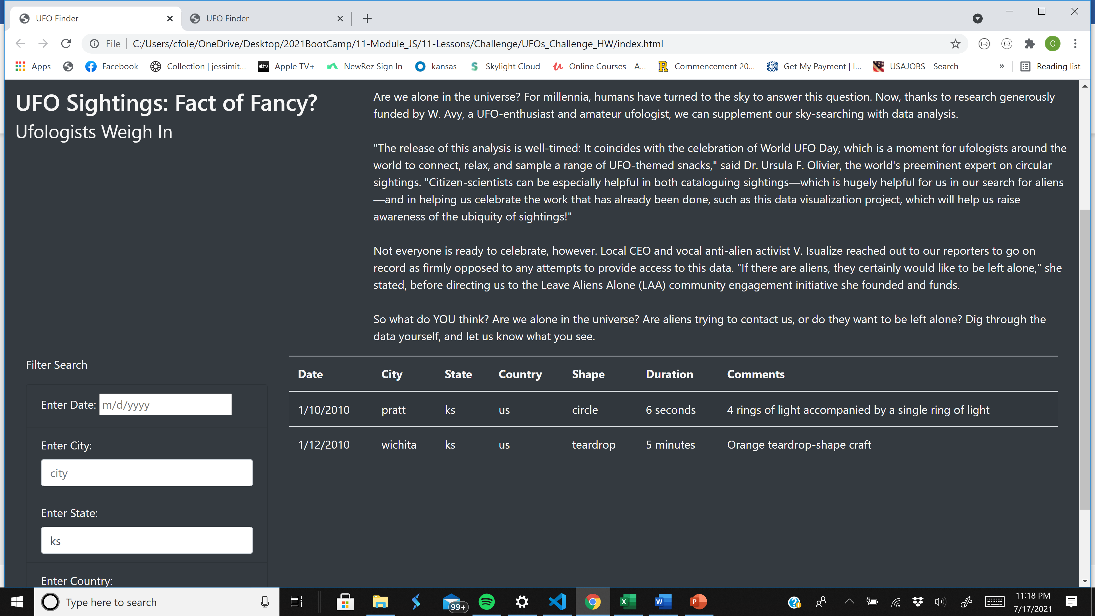
Enhanced Dynamic Table – Return Sightings for “ks”.

Slide 7
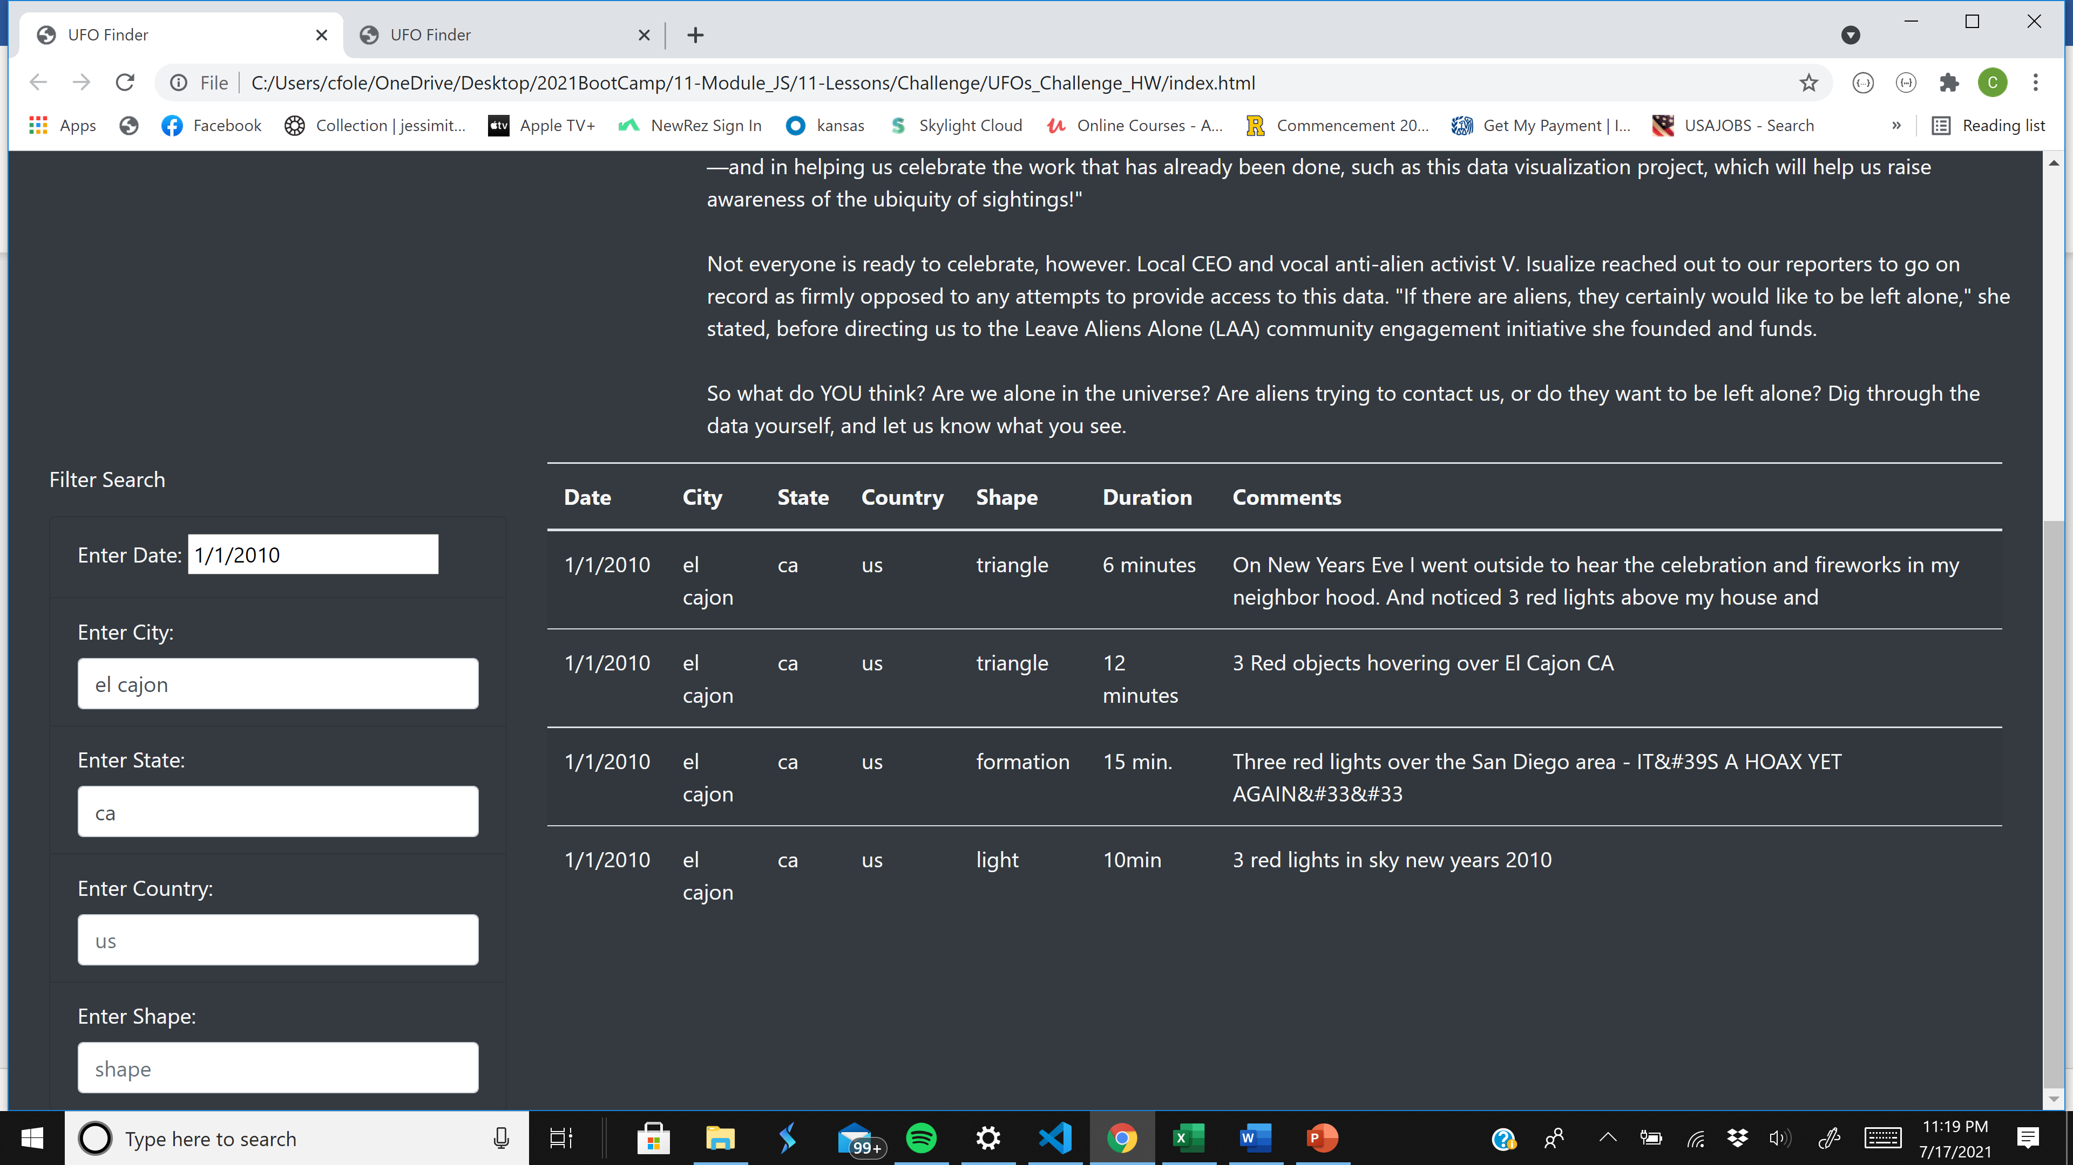
Enhanced Dynamic Table – Return Sightings for the city of “el cajon, ca” on “1/1/2010”.

Slide 8
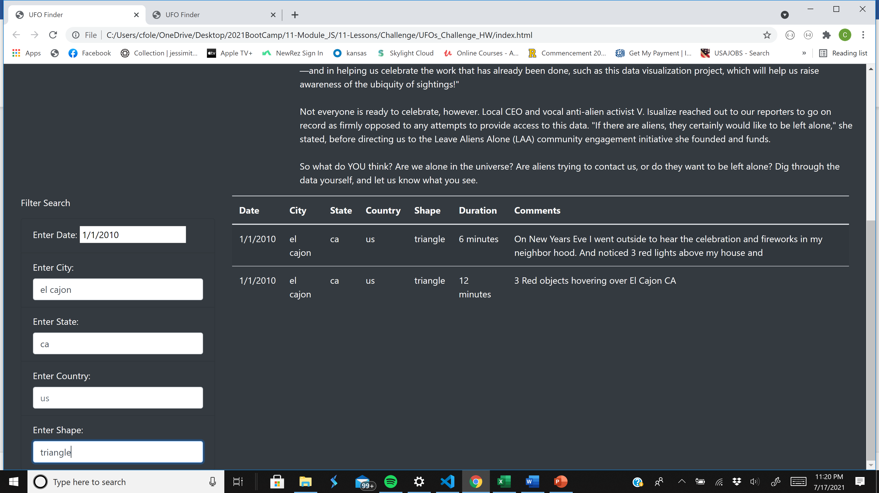
Enhanced Dynamic Table – Return Sightings for the city of “el cajon, ca” on “1/1/2010” that were shaped like a “triangle”.

Slide 9
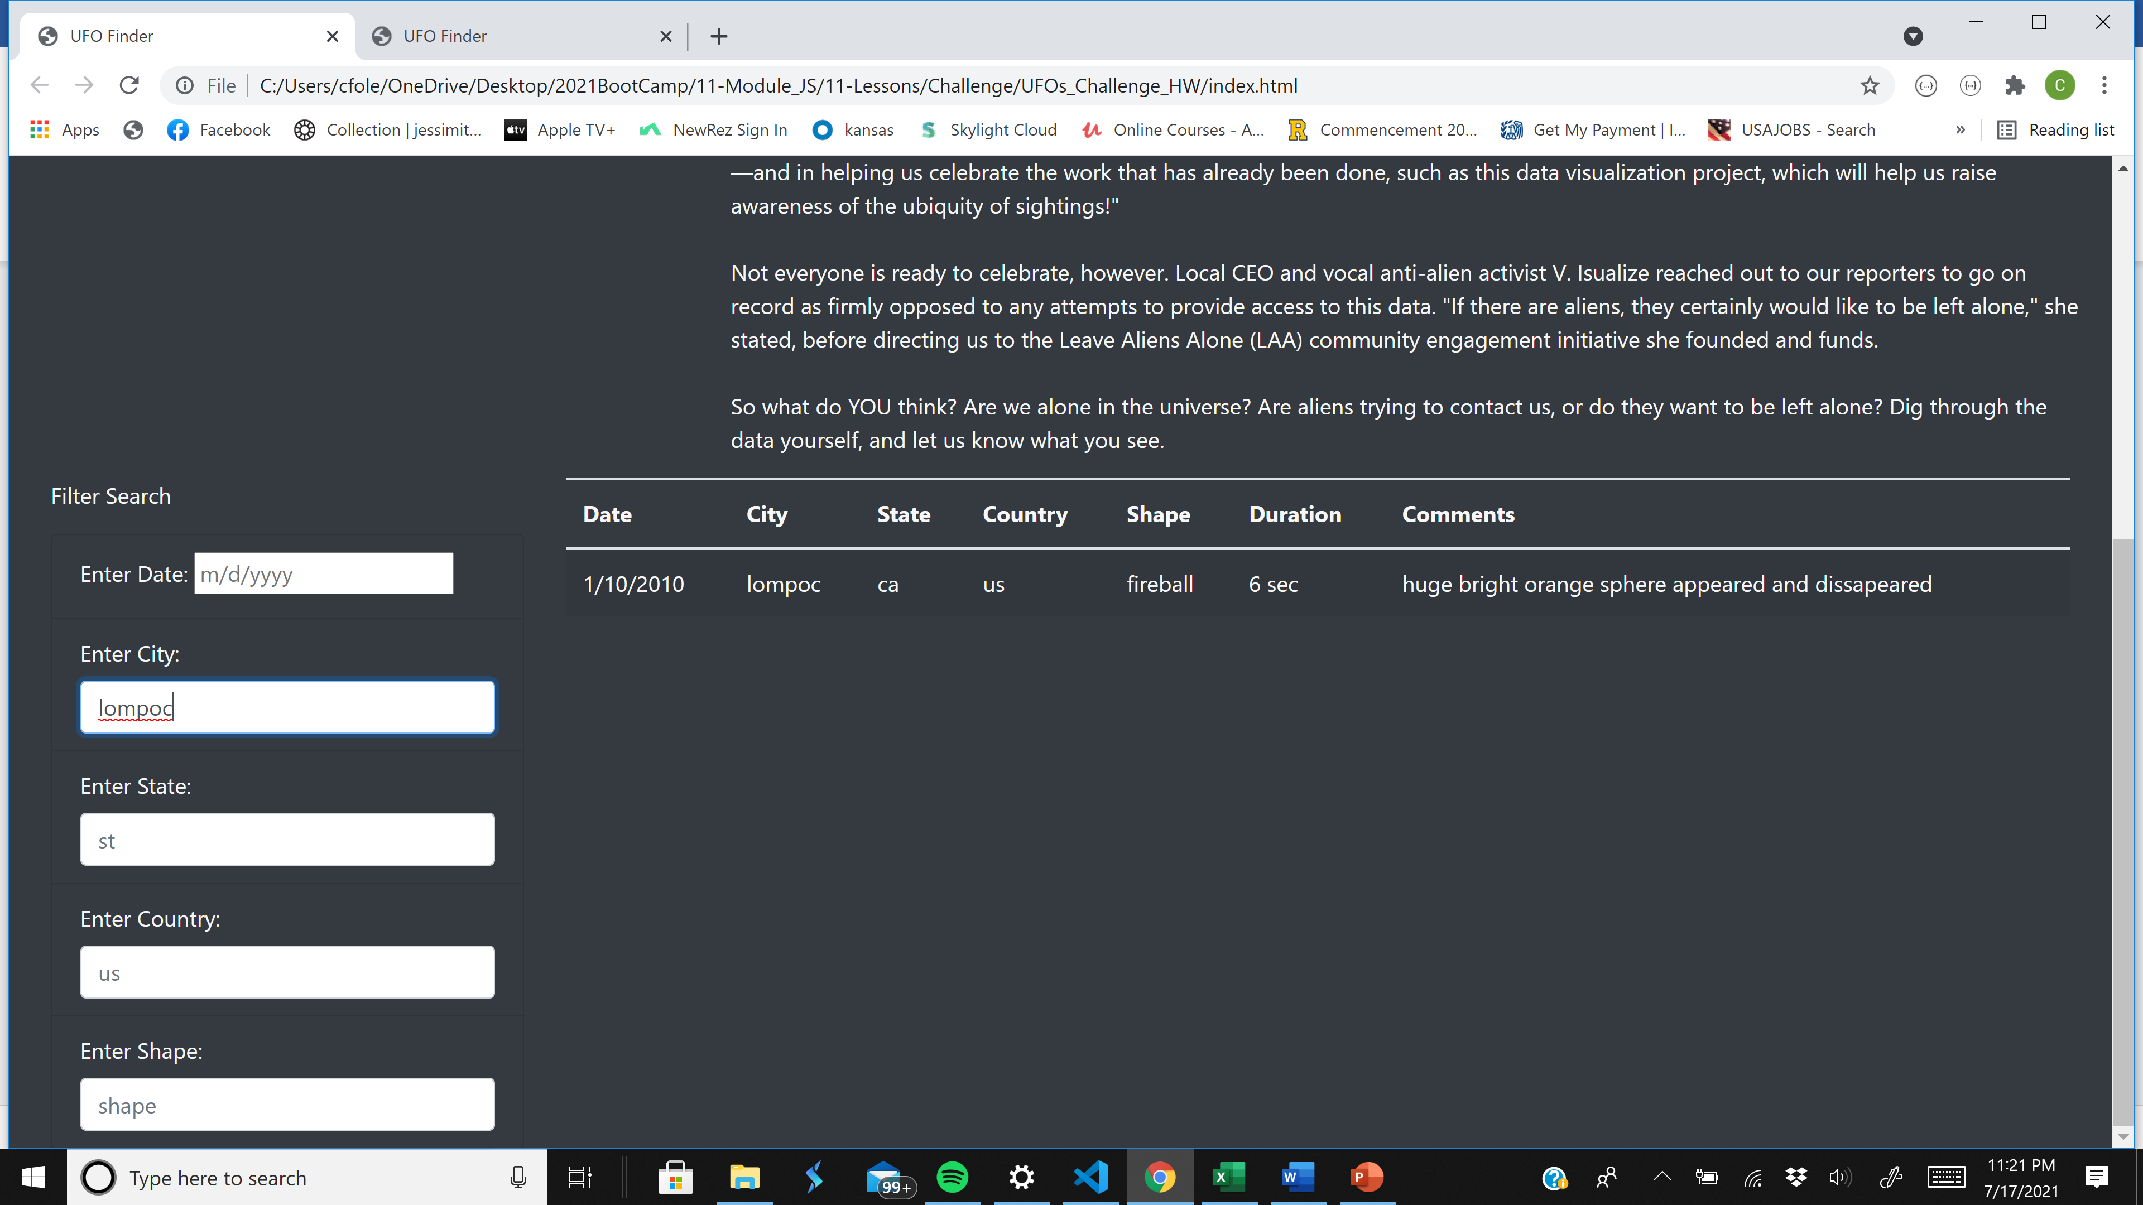
Enhanced Dynamic Table – Return Sightings for my hometown, the city of “lompoc”.

Slide 10

Enhanced Dynamic Table – Return Sightings that were shaped like a “disk” for the entire dataset.

